Slide 1
Unit 3: Physical Layer
LH-7
ROLISHA STHAPIT

Slide 2
CONTENTS
Introduction; Circuits (Circuit Configuration, Data Flow, Multiplexing); Communication Media (Twisted Pair Cable, Coaxial Cable, Fiber-Optic Cable, Radio, Microwave, Satellite, Media Selection); Digital Transmission of Digital Data (Coding, Transmission Modes, Digital Transmission, How Ethernet Transmits Data); Analog Transmission of Digital Data (Modulation, Capacity of a Circuit, How Modems Transmit Data); Digital Transmission of Analog Data (Translating from Analog to Digital, How Telephones Transmit Voice Data, How Instant Messenger Transmits Voice Data, Voice over Internet Protocol).

Slide 3
Introduction
The physical layer is the network hardware including servers, clients, and circuits, but we focus on the circuits and on how clients and servers transmit data through them. The circuits are usually a combination of both physical media (e.g., cables, wireless transmissions) and special-purpose devices that enable the transmissions to travel through the media.
The word circuit has two very different meanings in networking, and sometimes it is hard to understand which meaning is intended. Sometimes, we use the word circuit to refer to the physical circuit—the actual wire— used to connect two devices. In this case, we are referring to the physical media that carry the message we transmit, such as the twisted pair wire used to connect a computer to the LAN in an office.
In other cases, we are referring to a logical circuit used to connect two devices, which refers to the transmission characteristics of the connection, such as when we say a company has a T1 connection into the Internet. In this case, T1 refers not to the physical media (i.e., what type of wire is used) but rather to how fast data can be sent through the connection.
Often, each physical circuit is also a logical circuit, but sometimes it is possible to have one physical circuit—one wire—carry several separate logical circuits, or to have one logical circuit travel over several physical circuits.

Slide 4
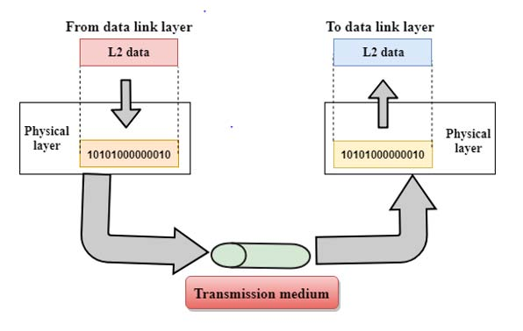
Functions of Physical Layer:
The physical layer consists of all the functions required to transmit a bitstream over a physical medium.
Physical layer devices or layer 1 devices are Hub, Repeater, Modem, Cables.
Main Functions
1. Representation of bits: The physical layer data involves a stream of bits (sequence of 0's and 1's) without any interpretation. To be transmitted, bits must be encoded into the signals - electrical or optical, or waves – radio or microwaves etc.
The physical layer defines the type of encoding (how 0's and 1's are changed in signals).
Physical layer encodes data in the form of electrical signals or the optical signals or the radio waves.
The physical layer is responsible for delivering those signals from a cable, an optical fiber or a Wi-Fi router.

Slide 5
2. Data Rate (Transmission Rate):
The number of bits sends each second is also defined by the physical layer.
In other words, the physical layer defines the duration of a bit also.
3. Synchronization of bits:
It is necessary to have synchronization between sender and receiver at the bit level.
4. Line configuration:
Physical layer is concerned with connection of devices to the channel or medium, whether point to point or multi-point.
5. Physical topology:
The physical topology determines how devices are connected to create a network.
Devices can be using a mesh topology, a star topology, a ring topology or a bus topology.

Slide 6
6. Transmission mode:
The mechanism of transferring data or information between two linked devices connected over a network is referred to as transmission mode.
They are simplex, half-duplex, or full-duplex.
7. Physical characteristics of media (Transmission medium):
It represents the types of transmission medium i.e; guided medium or unguided medium.

Slide 7
Data and Signals
The term analog data refers to information that is continuous; digital data refers to information that has discrete states.
To be transmitted, data must be transformed to electromagnetic signals.
Analog and Digital signals:
A signal is an electromagnetic or electrical current that is used for carrying data from one system or network to another.
A message encoded using electric current is called an electronic signal.

Slide 8
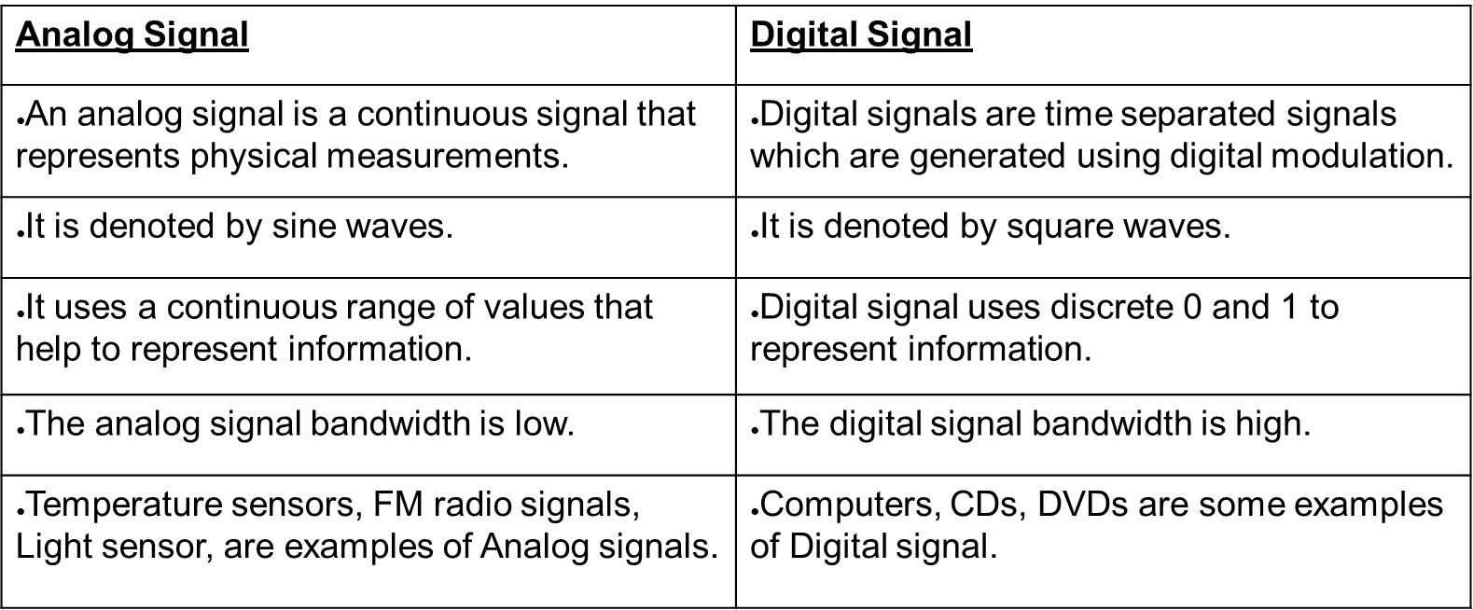
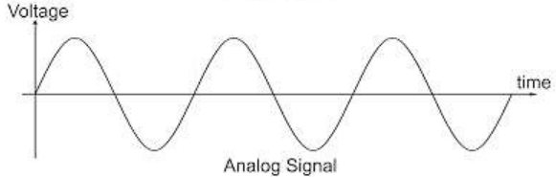
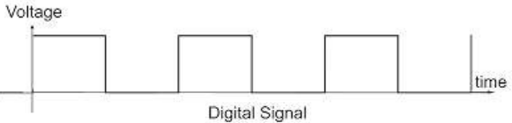

Slide 9
Signal:
It is the encoding of data in the form of electric or electromagnetic form. A signal can be defined as a function of one or more variables in time or frequency which conveys information generally about state or behaviour of a physical phenomena. Signal can be broadcast in two ways:
Time domain concept
Frequency domain concept

Slide 10
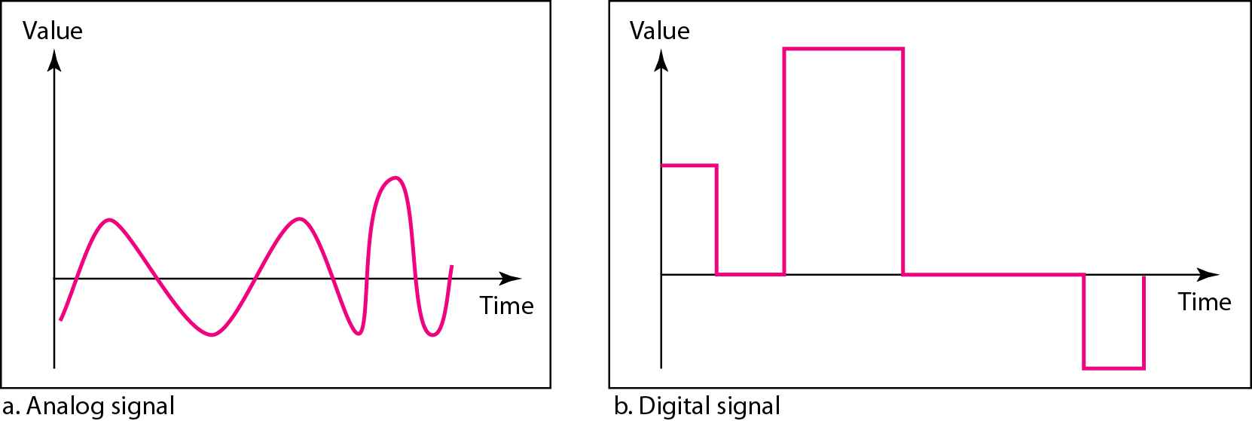
Time Domain Concept:
In this concept signal is the function of time. The signal may be analog or digital.
Analog signals can have an infinite number of values in a range. It is a continuous signal.
Digital signal has discrete values for a given range. Digital signals can have only a limited number of values.

Slide 11
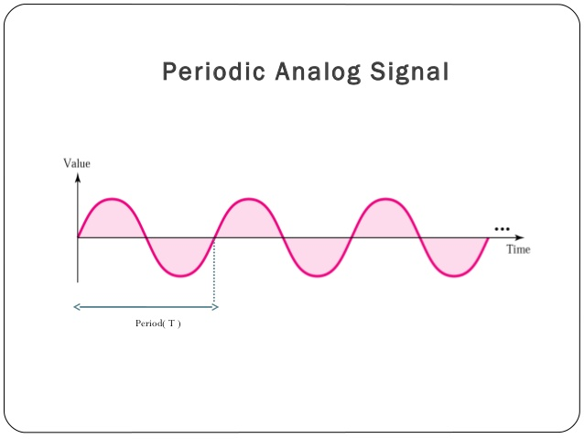
Periodic Signal:
The signal pattern repeats over the time. It is also known as sine wave. (can be either analog or digital)

Slide 12
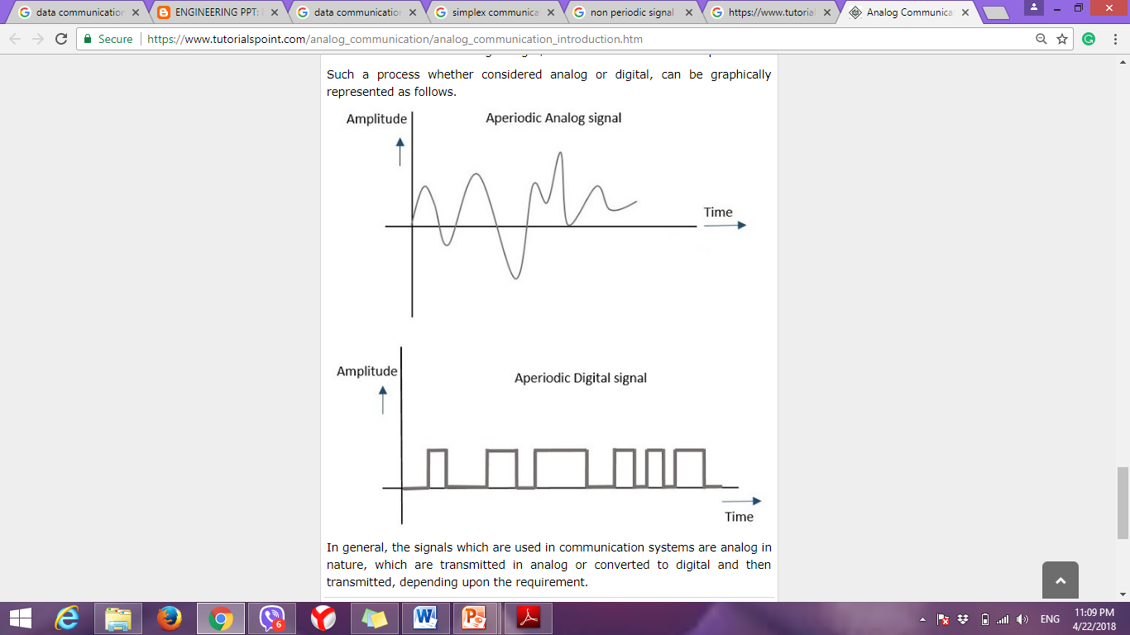
Non –Periodic Signal:
The same signal pattern that does not repeat over the time.

Slide 13
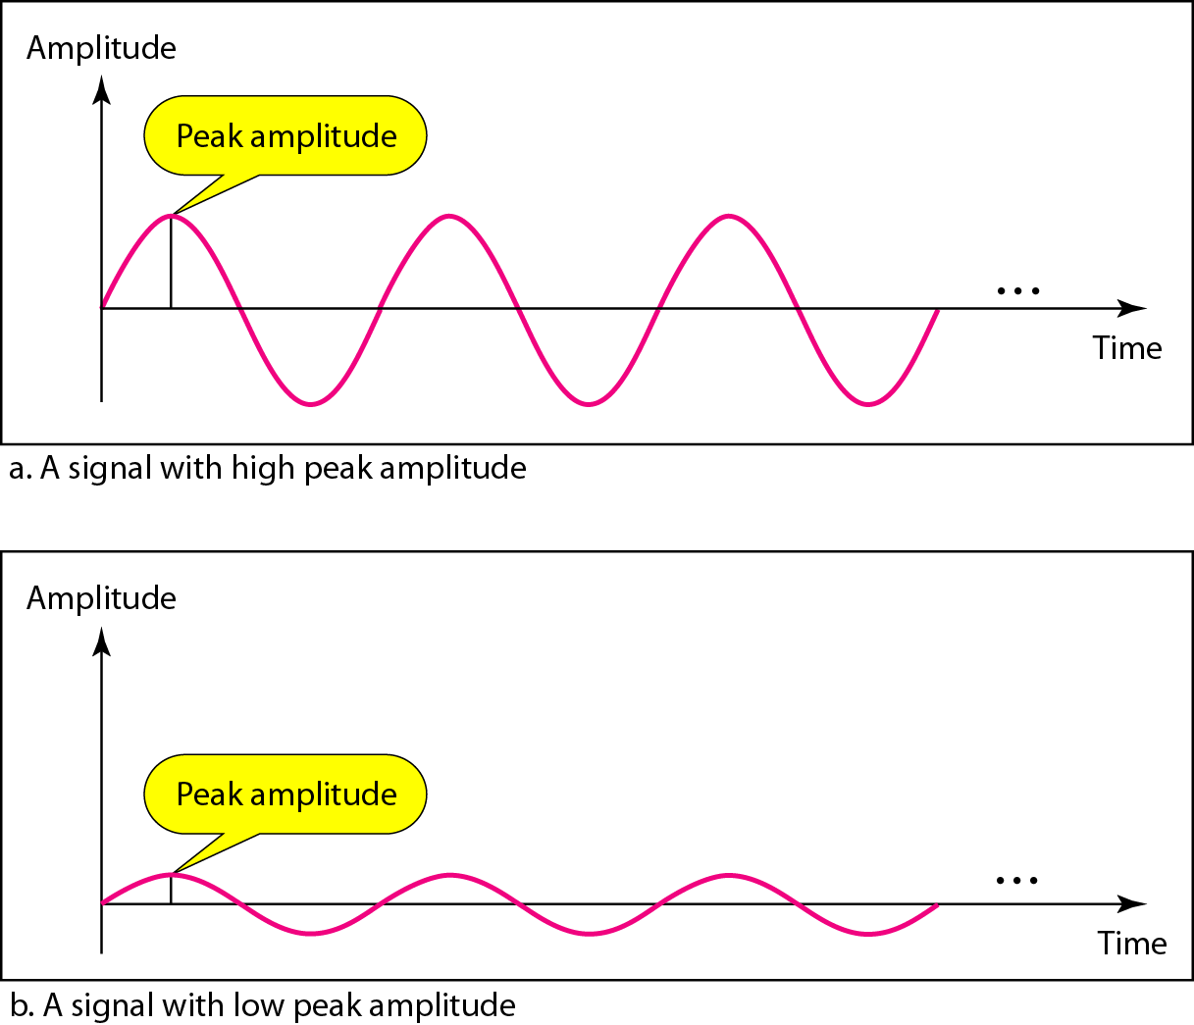
Amplitude:
Amplitude of a signal is the absolute value of its higher intensity proportional to the energy it carries. It is the strength of the signal. It is measured in term of voltage. It is denoted by ‘A’. It is the height of the wave above or below a given reference point.

Slide 14
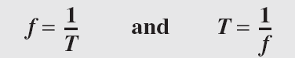
Frequency:
It refers to the number of periods in one second. It is the rate at which signal repeats. It is measured in terms of cycle per second or hertz (Hz) and it is denoted by ‘f’.
Mathematically, t= where t is time period.
Frequency and period are the inverse of each other.

Slide 15
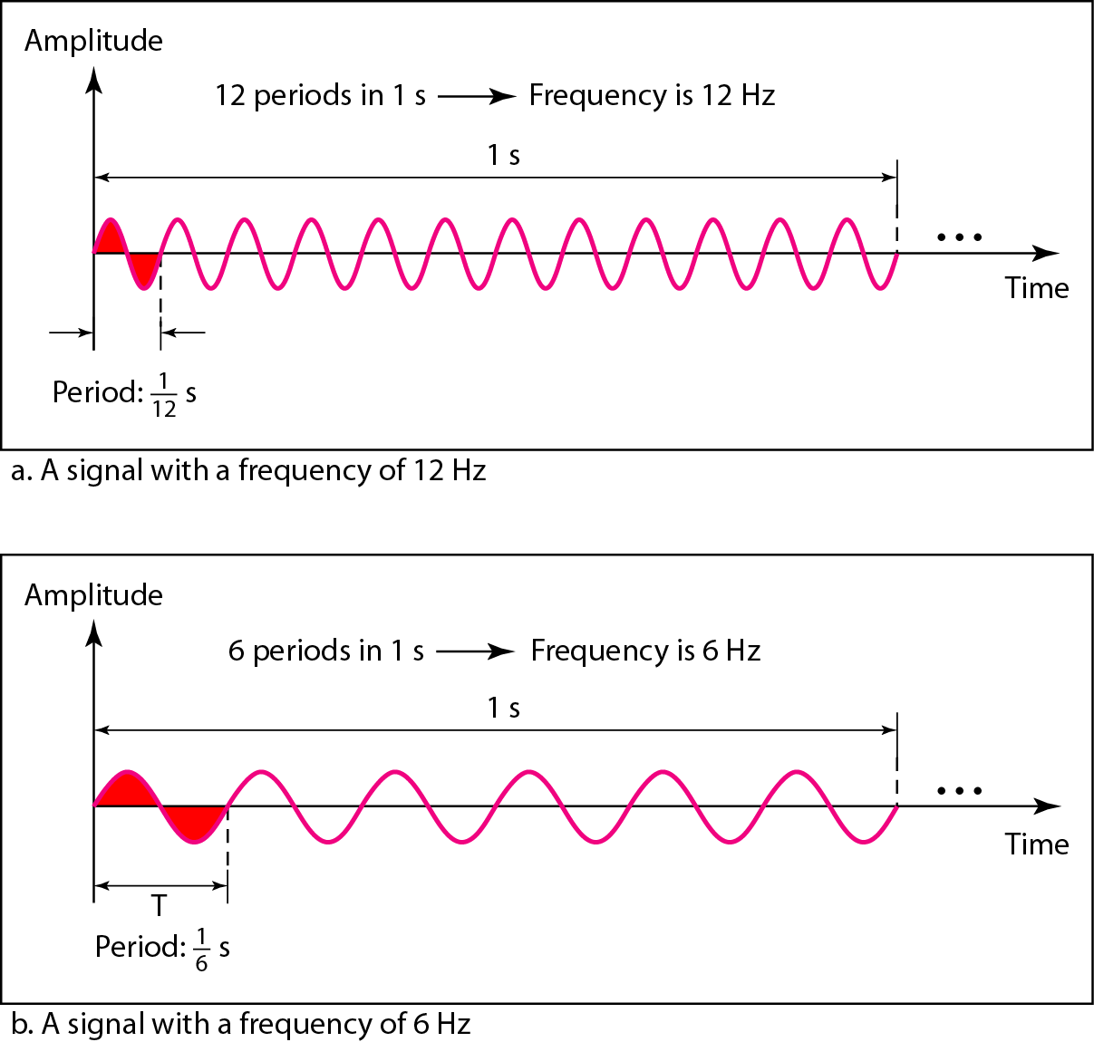

Slide 16
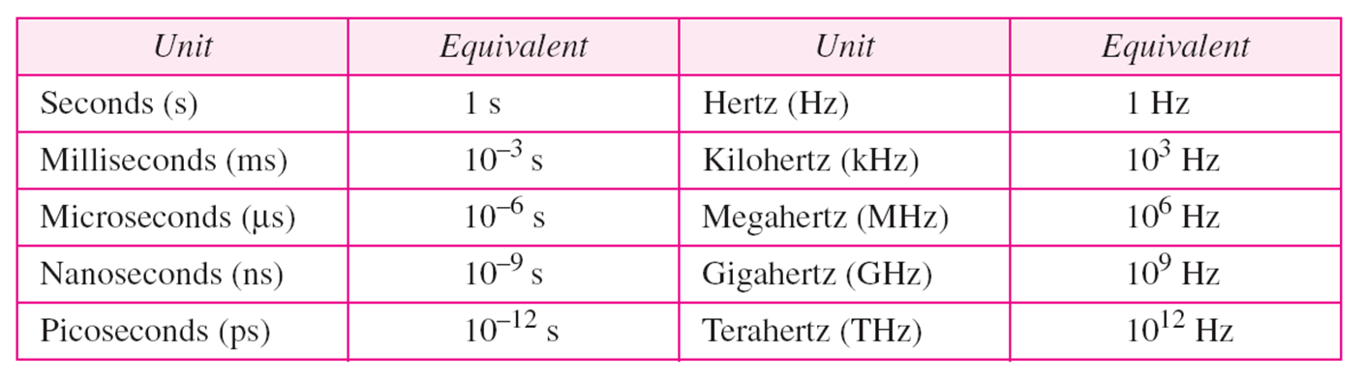
Units of period and frequency

Slide 17
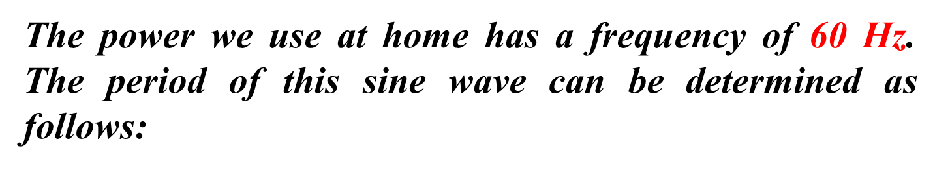
Example

Slide 18

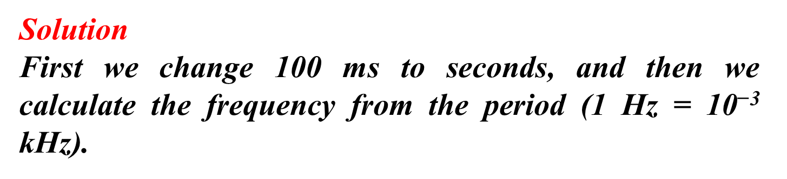

Slide 19
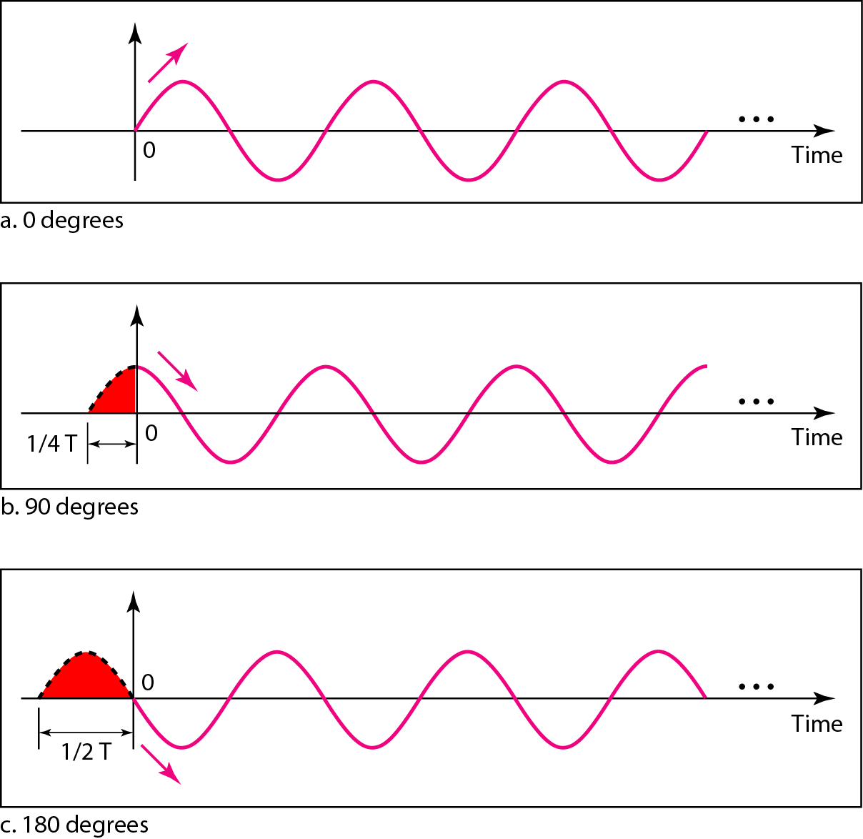
Phase:
Phase is a measure of relative position in time within single period of signal. It is measured in terms of radiant and it is denoted by ‘ϕ’. A change in phase can be any number of angles between 0 degree to 360 degree.

Slide 20
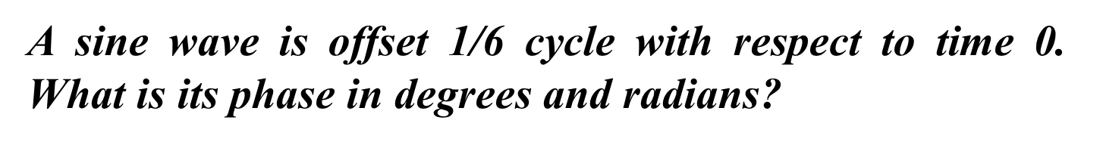


Slide 21


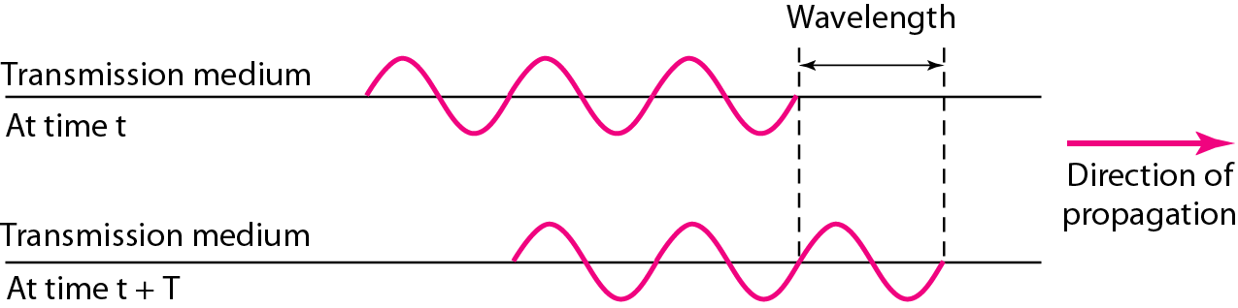
Wavelength:
It is the distance between identical points in the adjacent cycle of a waveform. It is also known as the distance occupied by a single cycle and it is denoted by
= =

Slide 22
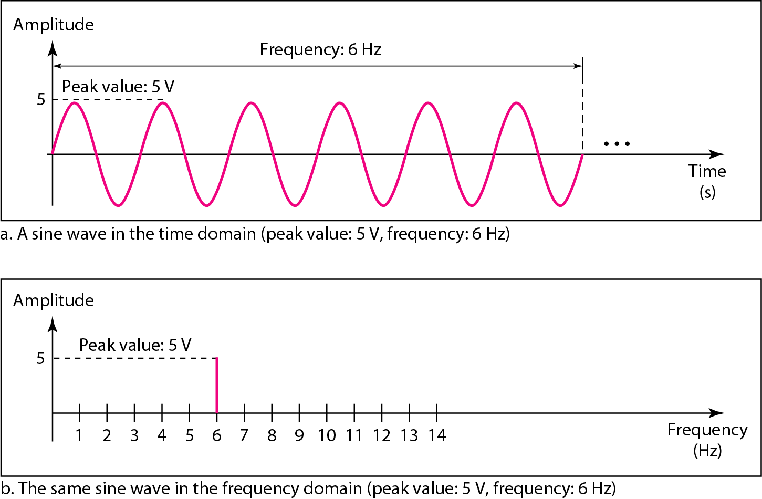
2. Frequency Domain Concept:
It refers to the analysis of mathematical function or signals with respect to frequency.

Slide 23
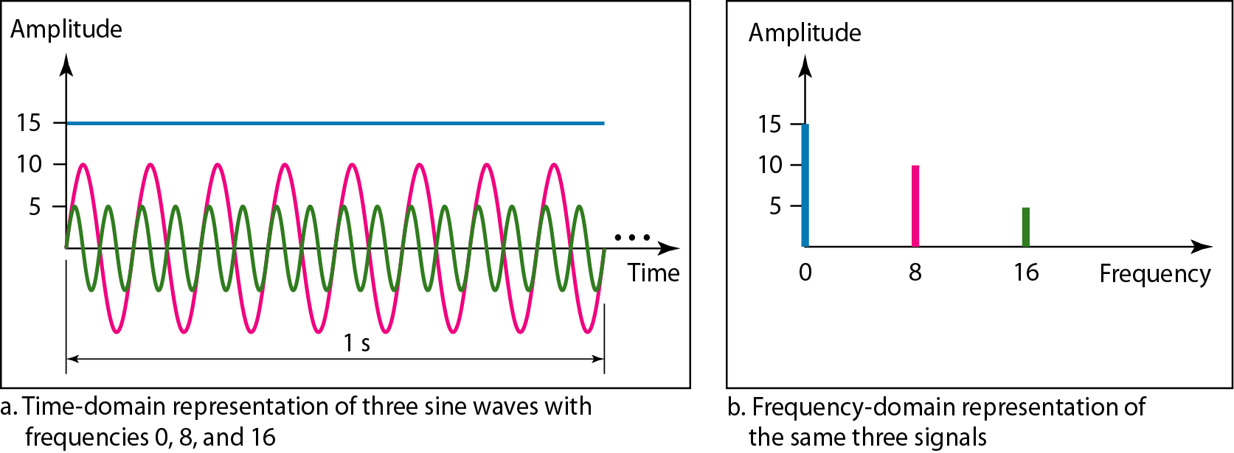
Draw the diagram for time domain and frequency domain
5V amplitude with 16Hz Frequency
10V amplitude with 8Hz Frequency
15V amplitude with 0Hz Frequency

Slide 24
Spectrum:
The range of the frequencies that the signal contains is called spectrum. It is the range of the frequencies in which the data operates.
Bandwidth:
It is the measure of how much information can flow from one place to another in the given amount of time. It is measured in terms of Hertz or bits per second.
Mathematically,
Bandwidth= Highest frequency- lowest frequency

Slide 25
Examples
A periodic signal has a bandwidth of 20 Hz. The highest frequency is 60 Hz. What is the lowest frequency.
Solution:
Bandwidth= Highest frequency- lowest frequency
lowest frequency = 60-20 = 40 Hz

Slide 26
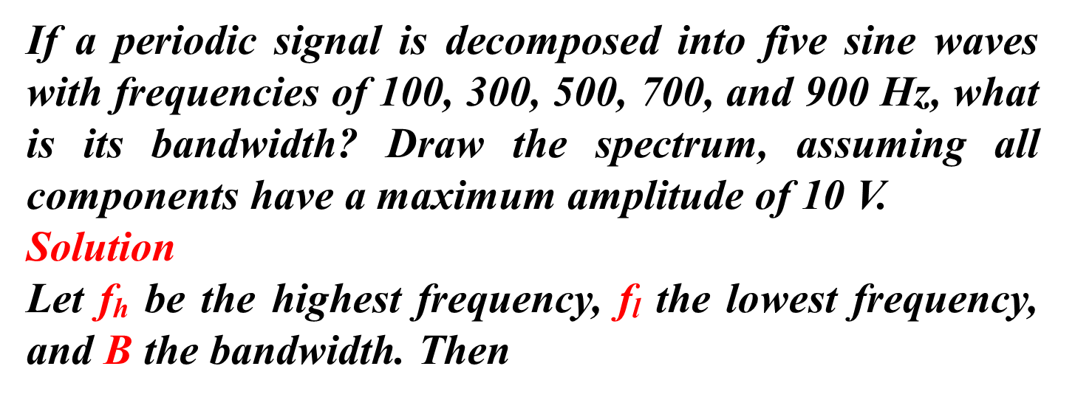

Slide 27
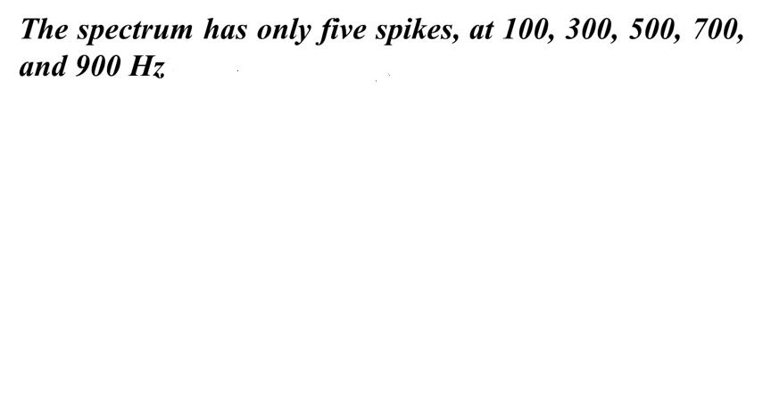
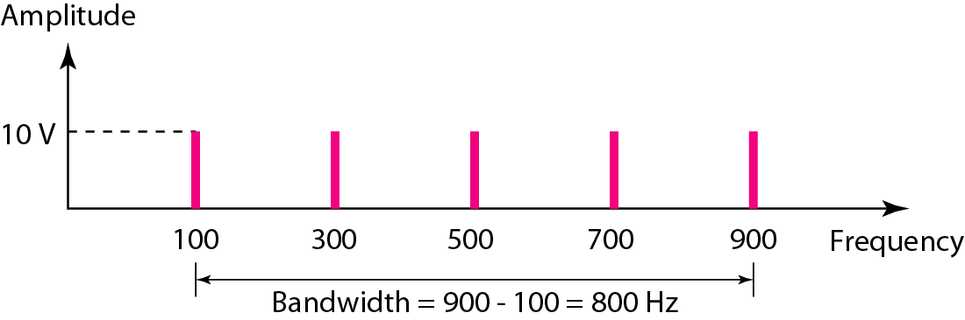

Slide 28
Bit rate:
It is a rate at which information can be transmitted in 1 sec. It is measured in terms of bits per second (bps).
Baud Rate:
Total number of bits used to represent a single information.
Example: 3- 11 (2 bit)
3- 011 (3 bit)
3- 0011 (4 bit)

Slide 29
Analog and Digital Data Transmission:
Analog Data:
1. Audio Signals: (Human Speech)
frequency range 20Hz-20kHz (speech 100Hz-7kHz)
easily converted into electromagnetic signals
Varying volume converted to varying voltage. The telephone handset contains a simple mechanism for making such a conversion.
can limit frequency range for voice channel to 300-3400Hz
2. Video Signals: (produced by Video Camera)
Frequency range 0 to 6 MHz

Slide 30
Digital Data:
as generated by terminals, computers, and other data processing equipment and then converted into digital voltage pulses for transmission
uses two constant (dc) voltage levels, one level for binary 1 and one level for binary 0
In a communications system, data are propagated from one point to another by means of electromagnetic signals. Both analog and digital signals may be transmitted on suitable transmission media.

Slide 31
In Analog transmission:
the signals that are in either analog or digital form are propagated by means of continuously varying electromagnetic wave i.e. analog signal over a variety of media, depending on spectrum; examples are wire media, such as twisted pair and coaxial cable; fiber optic cable; and unguided media, such as atmosphere or space propagation.
doesn’t concerned with the content of the signal
for a long distance transmission, amplifiers are used to boost the energy in signal but it also boost the noise components that distorts the desired signal

Slide 32
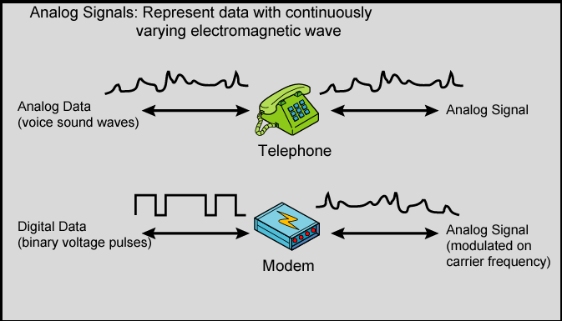
Analog Voice signals are converted into analog electromagnetic signals by telephone.
Digital data are converted into analog using a modem (modulator/demodulator) by modulating the digital data on some carrier frequency

Slide 33
In digital transmission:
Sequence of voltage pulses i.e. Digital signal is transmitted over a wire medium;
Both analog signals and digital data from source are converted into digital form.
Analog data can converted to digital using a codec (coder-decoder), which takes an analog signal that directly represents the voice data and approximates that signal by a bit stream.
Digital data can be directly represented by digital signals.

Slide 34
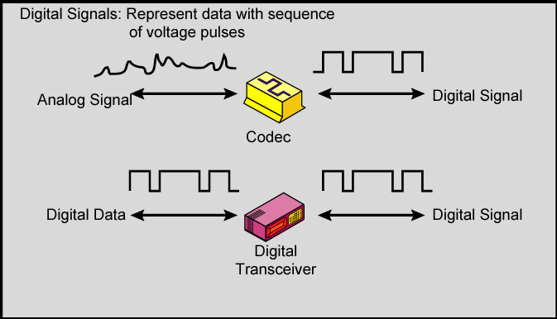

Slide 35
Digital Transmission over Analog Transmission
Digital technology
- Continuous drop in cost and size of digital circuits as compared to Analog equipment
Data Integrity
- Digital signals are less susceptible to noise and repeaters are used instead of amplifiers, so maintains data integrity
Capacity Utilization
- Easier to multiplex several digital signals
Security and Privacy
- Encryption technique can be used
Integration
- All signals in different format (audio, video or text) are integrated into a common format of 1 and 0.

Slide 36
Circuits
Circuit configuration is the basic physical layout of the circuit. There are two fundamental circuit configurations: point-to-point and multipoint. In practice, most complex computer networks have many circuits, some of which are point-to-point and some of which are multipoint.
Point-to-Point Communication:
Point-to-point circuit, which is so named because it goes from one point to another (e.g., one computer to another computer). These circuits sometimes are called dedicated circuits because they are dedicated to the use of these two computers. This type of configuration is used when the computers generate enough data to fill the capacity of the communication circuit.

Slide 37
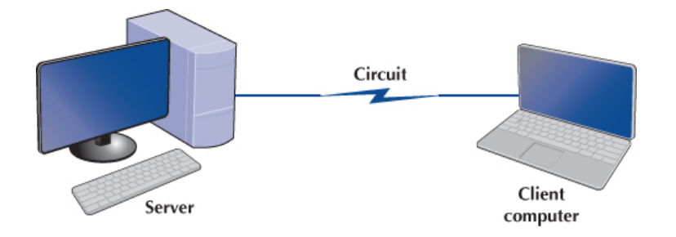
When an organization builds a network using point- to-point circuits, each computer has its own circuit running from itself to the other computers. This can get very expensive, particularly if there is some distance between the computers. Despite the cost, point-to-point circuits are used regularly in modern wired networks to connect clients to switches, switches to switches and routers, and routers to routers.

Slide 38
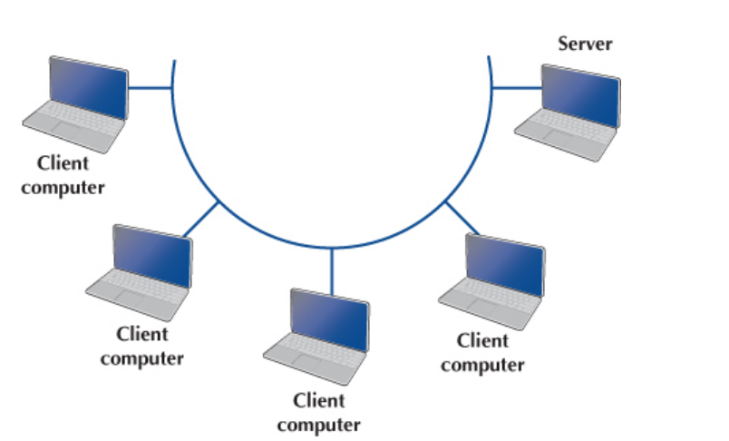
2. Multipoint Circuit:
In this configuration, many computers are connected on the same circuit. This means that each must share the circuit with the others. The disadvantage is that only one computer can use the circuit at a time. When one computer is sending or receiving data, all others must wait. The advantage of multipoint circuits is that they reduce the amount of cable required and typically use the available communication circuit more efficiently.
Multipoint circuits typically are used when each computer does not need to continuously use the entire capacity of the circuit or when building point-to-point circuits is too expensive. Wireless circuits are almost always multipoint circuits because multiple computers use the same radio frequencies and must take turns transmitting.

Slide 39
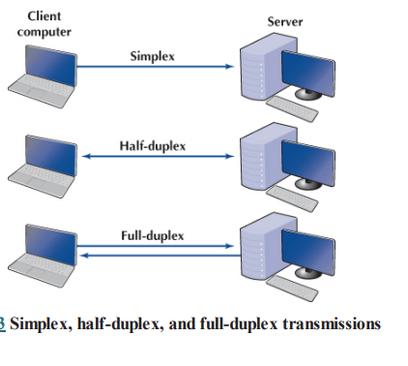
Data Flow
Circuits can be designed to permit data to flow in one direction or in both directions. Actually, there are three ways to transmit: simplex, half-duplex, and full-duplex

Slide 40
Simplex: It is the one way communication in which the sender sends the information but the receiver cannot acknowledge to the sender. The receiver has to receiver data even if the sender sends wrong data. Eg: Broadcasting information from radio.
2. Half Duplex: The channel supports two way communication but only one station at a time can send or receive data. When the data is transmitted, the receiver has to wait until the data is sent and then the channel can be occupied by the receiver. Eg: Walkie Talkie.
3. Full Duplex: It is a two way communication in which the sending and receiving of the signal can be done simultaneously. It is like a two way street with traffic flowing in both direction at a same time. Eg: telephone network, mobile communication.

Slide 41
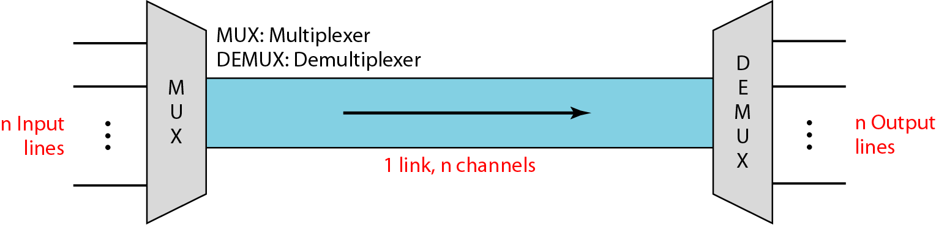
MULTIPLEXING TECHNIQUES
Whenever the bandwidth of a medium linking two devices is greater than the bandwidth needs of the devices, the link can be shared otherwise bandwidth is wasted. Multiplexing is the set of techniques that allows the simultaneous transmission of multiple signals across a single data link.

Slide 42
n input lines share the bandwidth of one link.
Multiplexer(MUX) combines input lines into a single stream(many-to-one).
De-multiplexer(DEMUX) separates the stream back into its component transmissions and directs them to corresponding lines.
Channel:- portion of a link that carries a transmission between a given pair of lines.

Slide 43
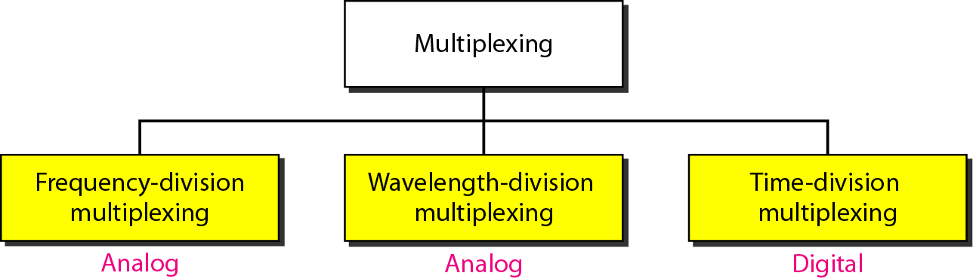
Categories of multiplexing

Slide 44
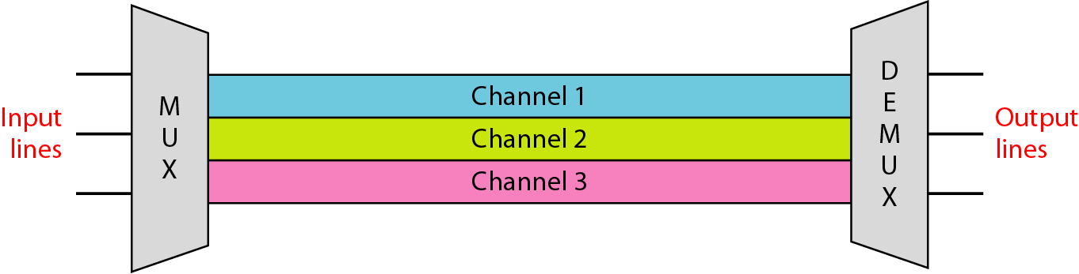
Frequency-division multiplexing (FDM):
Applied when the bandwidth of a link is greater than the combined bandwidth of the signals to be transmitted.
Signal generated by source modulate different carrier frequencies.
Channels are separated by certain guard bands to prevent interference.

Slide 45
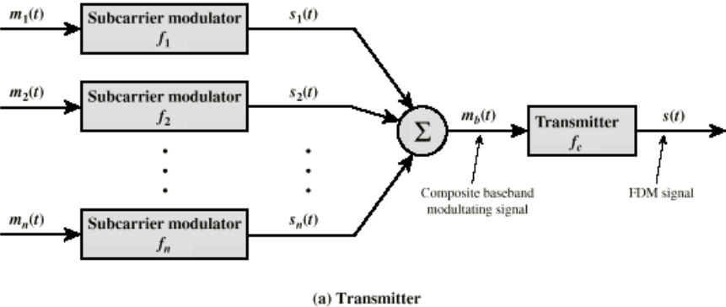
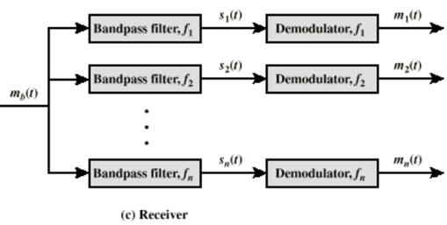
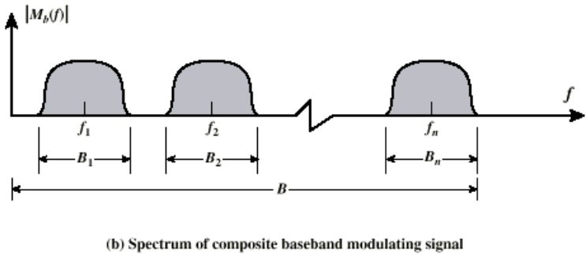
Frequency-division multiplexing & de-multiplexing process

Slide 46
Number of analog or digital signals (mi(t), i = 1,…n) are multiplexed onto the same transmission medium.
mi(t), is modulated onto a carrier fi (subcarrier).
Modulated signals are summed to produce a composite signal mb(t).
At receiving end, composite signal is passed through n bandpass filters, each centered on fi, and having a bandwidth Bi, to retrieve separate modulated signals(si(t)) .
Each splitted signal(si(t)) is demodulated to recover the original signal mi(t).

Slide 47
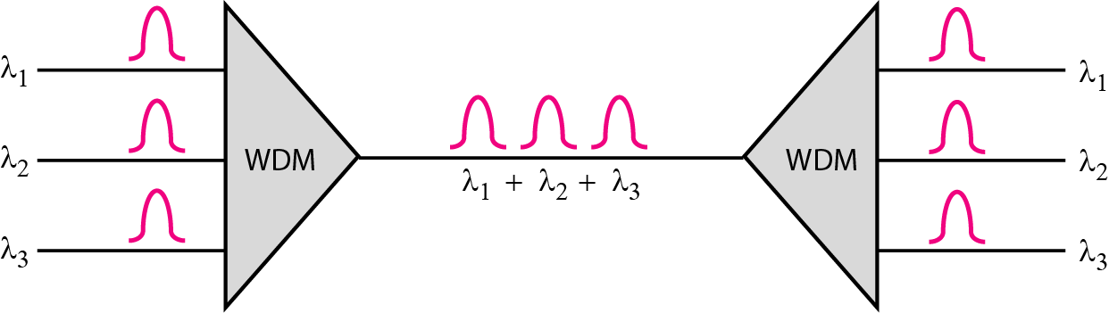
Wavelength-division multiplexing (WDM):
Analog multiplexing technique to combine optical signals.
Conceptually same as FDM but multiplexing and de-multiplexing involve optical signals transmitted through fiber-optic channels.
Very narrow beams of light(many colors or wavelengths) from different sources are combined to make a wider band of light.

Slide 48
Time Division Multiplexing (TDM):
TDM is a digital multiplexing technique for combining several low-rate channels into one high-rate one.
TDM is done if achievable data rate(bandwidth) of the medium exceeds the data rate of digital signals to be transmitted.
Multiple digital signals (or analog signals carrying digital data) carried on a single transmission path by interleaving portions of each signal in time.
Interleaving can be at the bit level or in blocks of bytes or larger quantities.

Slide 49
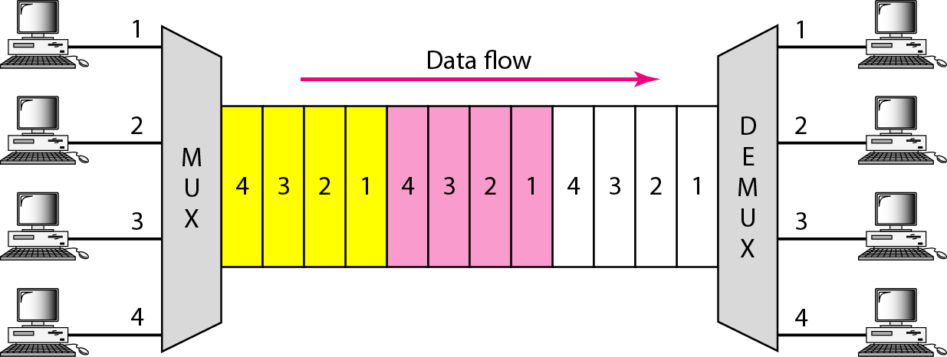

Slide 50
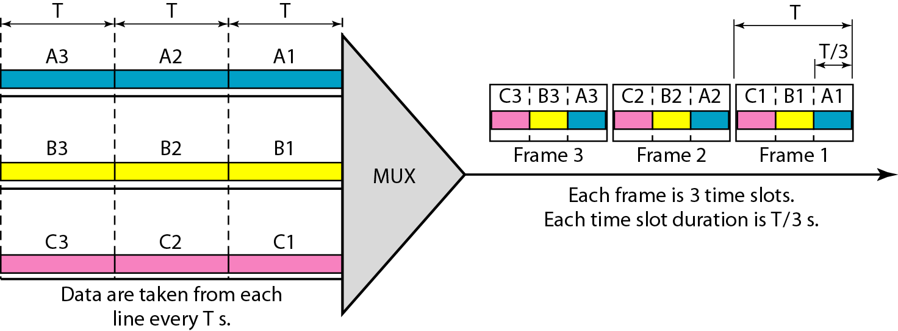
Synchronous Time Division Multiplexing
Data units(1 bit, one character, one block of data) from each input connection is collected into a frame.
For n connections, a frame is divided into n time slots and one slot is allocated for each unit(input line).
For T duration of the input unit, duration of each slot is T/n and the duration of each frame is T.
In synchronous TDM, the data rate of the link is n times faster, and the unit duration is n times shorter.

Slide 51
Statistical Time Division Multiplexing
In synchronous TDM, each input has a reserved slot in the output frame even when an input link may have no data to transmit(wasteful of bandwidth) .
In statistical time division multiplexing, slots are dynamically allocated for an input line if the line has data to send, in round-robin fashion.
The number of slots in each frame is less than the number of input lines.
In statistical TDM, a slot need to carry data as well as the address of the destination because there are no pre-assigned or reserved slots.
But in synchronous TDM, there is no need for addressing; synchronization and pre-assigned relationships between the inputs and outputs serve as an address.
frames in statistical TDM need not be synchronized, so we don’t need synchronization bits.

Slide 52
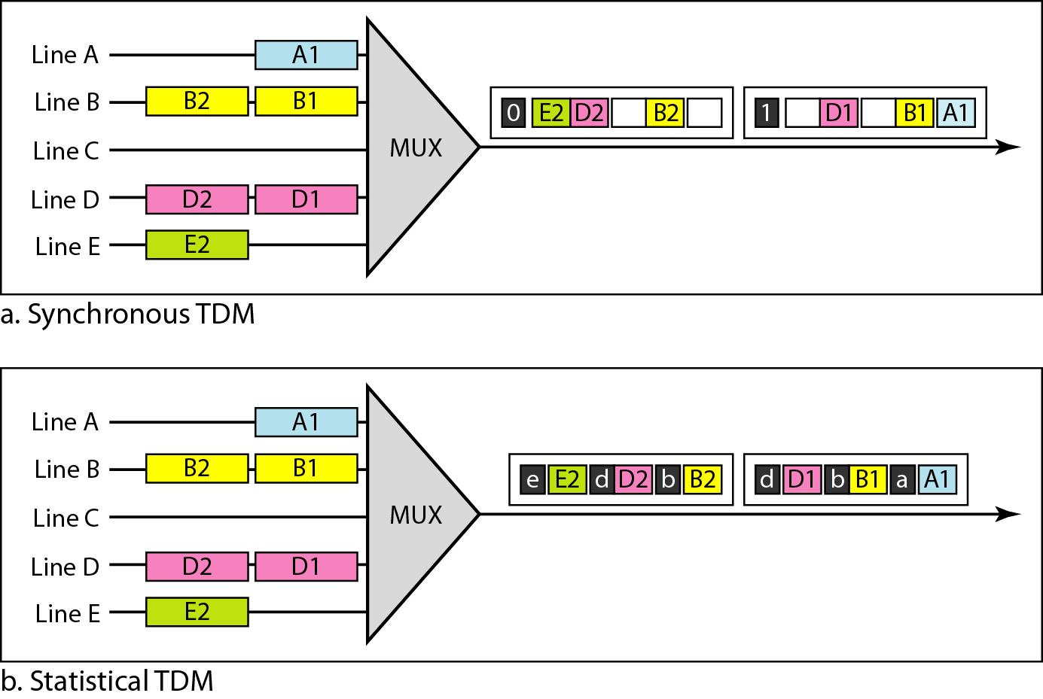
TDM slot comparison

Slide 53
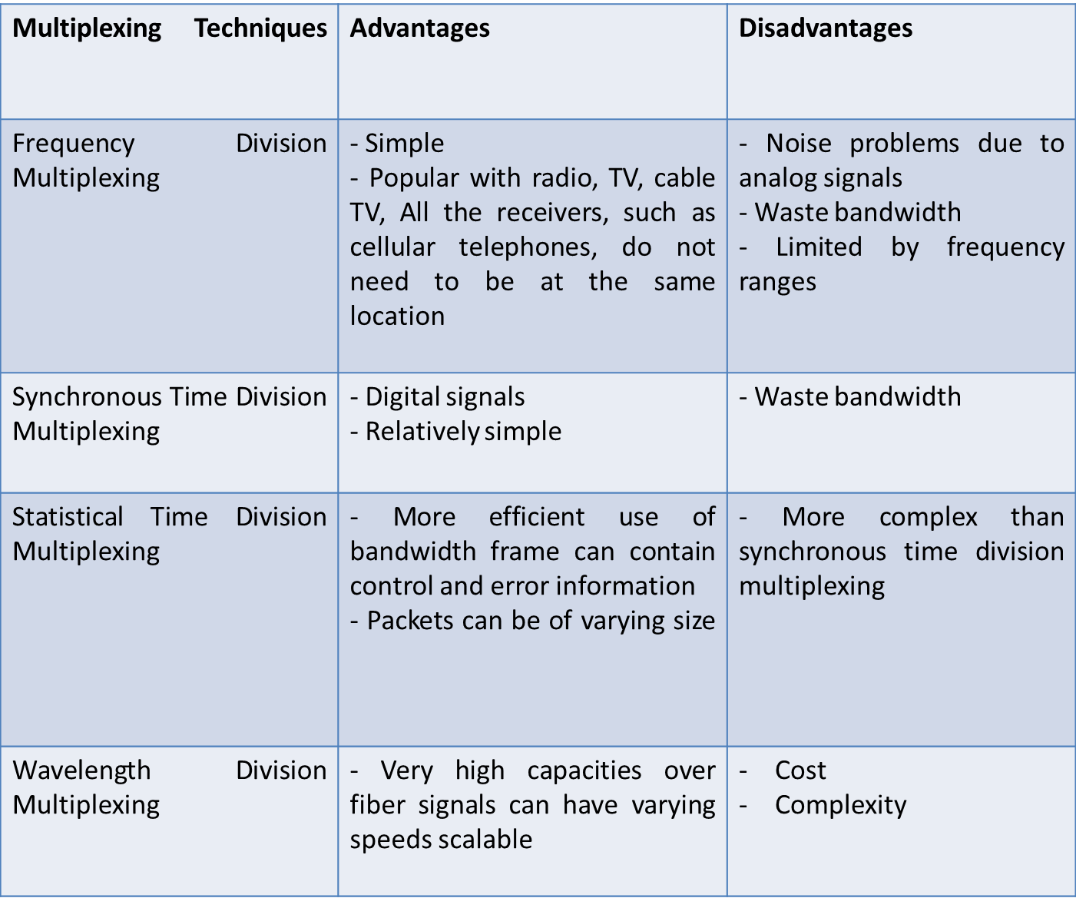
Advantages and Disadvantages of multiplexing techniques:

Slide 54
Communication Media (Transmission Media)
A transmission medium is required to carry information from a source to a destination. The information is usually a signal that has to travel a long distance. For this the transmission media can be wired or wireless.
In wired transmission, the signal travels along the cable from one device to another. But in wireless transmission the electromagnetic waves are transmitted without using a physical conductor.

Slide 55
Types of Communication Media
Guided Media (Bounded Media):
These media transmit signals electrically or light over cable or wire. Eg: twisted pair cable, coaxial cable, and optical fiber.
2. Unguided Media (Unbounded Media):
These media transmit data through the open air.eg: radio waves or infrared signals and satellite.

Slide 56
Types of Guided Media
Following are the three common types of guided media:
Twisted Pair
Coaxial Cable
Optical Fiber
Twisted pair:
Twisted pair cable is a common scheme for using copper wire as telecommunication cable. It consists of two insulated strands of copper wire twisted around each other. Each twisted pair cable each pair would consist of a wire used for the positive data signal and a wire used for negative data signal. Any noise that appears on one wire of the pair would occur on the other wire, because the wires are of the opposite polarities.

Slide 57
When the noise appears on both wires it cancels or nullifies itself out at the receiving end. The twisting is done in the twisted pair in order to avoid interference of noise.
It is of two types:
Unshielded Twisted Pair (UTP)
Shielded Twisted Pair (STP)
a. Unshielded Twisted Pair (UTP):
UTP cables consists of a number of twisted pair of wires with a simple plastic casing. It is commonly used in telephone line system. There is a tendency of crosstalk. To decrease the amount of crosstalk (coupling of wires) and outside interference the wires are twisted. It is used on ethernet.

Slide 58
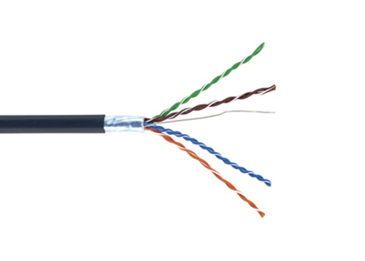
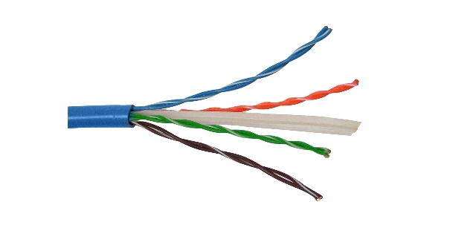
b. Shielded Twisted Pair (STP):
STP cable is similar ins construction to UTP except that the twisted pair is enclosed in a woven copper for providing extra protection from external interference. It is expensive than that of UTP. It uses high frequency.
Figure: UTP
Figure: STP

Slide 59
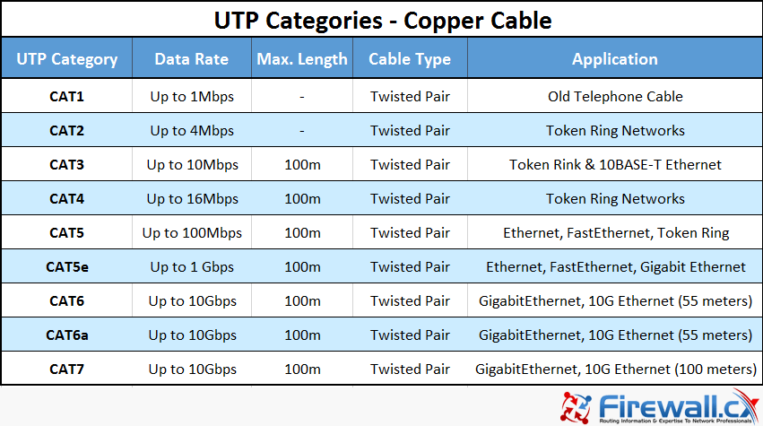

Slide 60
2. Coaxial Cable:
Coaxial cable (coax) carries high frequency signals than twisted-pair cables.
Coax has a central core conductor of solid wire enclosed in an insulator, which is covered by an outer conductor of metal foil. This outer conductor completes the circuit.
Outer conductor is also enclosed in an insulator, and the whole cable is protected by a plastic cover. It was the foundation for Ethernet networks in the 1980s and remained a popular transmission medium for many years.
Over time, however, twisted-pair cabling has replaced coax in most of the modern LANs.

Slide 61
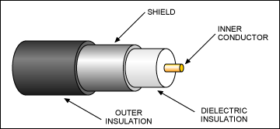
A coaxial cable is made up of a central copper wire called a core surrounded by an insulator and then a braided metal shield.

Slide 62
i) The jacket or outer insulation protects the cable from the external environment. It is usually made of rubber or sometimes Polyvinyl chloride (PVC) or Teflon.
ii) The shield (Metal envelope) surrounding the cables protects the data transmitted on the medium from interference (noise) that could corrupt data.
iii) The insulator surrounding the central core is made of a dielectric material that prevents any contact with the shield that could cause electrical interactions or short circuit.
iv) The core, which actually transports the data, generally consists of a single copper strand or several braided strands.

Slide 63
Because of its insulation and protective braiding, coaxial cable has a high resistance to interference from noise. It can also carry signals farther than twisted pair cabling before amplification of the signals becomes necessary, although not as far as fiber optic cabling.
Normally, two types of coaxial cable are used.
1. 10Base2 – Thin Coaxial Cable (called Thinnet or CheaperNet) is a thin cable (6 mm in diameter), that is white or grayish by convention. It is very flexible and can be used in most networks by connecting it directly to the network card. It is able to transport a signal up to around 185 meters without line loss. It is part of the RG-58 family whose impedance (resistance) is 50 ohms. The different types of thin coaxial cables are differentiated by the central part of the cable (core).

Slide 64
2. 10Base5 – Thick Coaxial Cable (Thicknet or Thick Ethernet and also called Yellow cable, because of its yellow color – by convention) is a shielded cable with a thicker diameter (12 mm) and 50 ohm impedance. It was used for a long time in Ethernet networks, which is why it is also known as “Standard Ethernet Cable”. Given that it has a larger-diameter core, it is able to carry signals over long distances: up to 500 meters without line loss (and without signal amplification). It has a bandwidth of 10 Mbps and is very often used as a backbone to connect networks whose computers are connected with Thinnet. However, because of its diameter, it is less flexible than Thinnet.

Slide 65
3. Optical Fiber:
A fiber-optic cable is made of glass or plastic and transmits signals in the form of light.
To understand optical fiber, we first need to explore several aspects of the nature of light.
Light travels in a straight line as long as it is moving through a single uniform substance.
If a ray of light traveling through one substance suddenly enters another substance (of a different density), the ray changes direction.
Fiber optics, or optical fiber, refers to the medium and the technology associated with the transmission of information as light pulses along a glass or plastic strand or fiber.
A fiber optic cable can contain a varying number of these glass fibers - from a few up to a couple hundred.

Slide 66
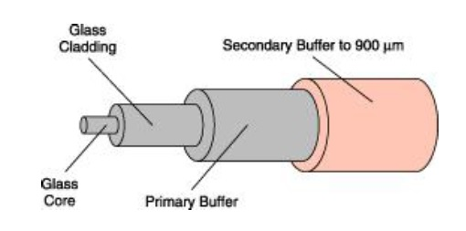
This system of transmission works on the principle of Total Internal reflection.
All fibers consist of a number of substructures including:
A core, which carries most of the light, surrounded by
A cladding, which bends the light and confines it to the core, surrounded by
A substrate layer (in some fibers) of glass which does not carry light, but adds to the diameter and strength of the fiber, covered by
A primary buffer coating, this provides the first layer of mechanical protection, covered by
A secondary buffer coating, this protects the relatively fragile primary coating.

Slide 67
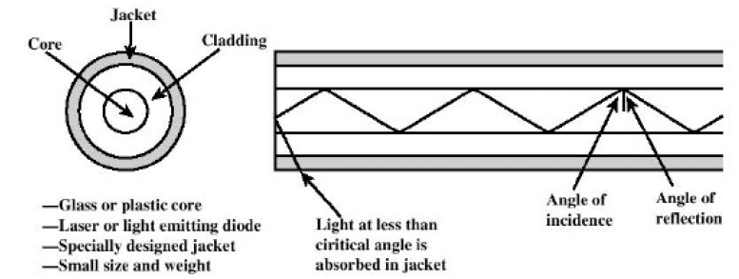
Principle of Fiber-optics:
It is based on the principle of Total internal Reflection.
The glass in optical fibers is made so that light is unable to emerge sideways from the glass. This is achieved by covering the glass with a cladding of denser glass or plastic. As light travels from the inner glass core to the denser cladding, it bends so much that, instead of leaving the glass, it is reflected back into it. This process is known as total internal reflection.

Slide 68
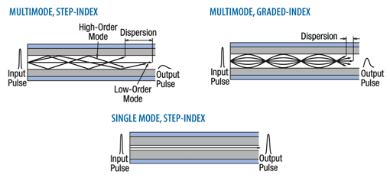
Current technology supports two modes: multimode and single mode for propagating light along optical channels, each requiring fiber with different physical characteristics. Multi- mode can be implemented in two forms: step-index or graded-index .

Slide 69
Single Mode:
• It uses step index fiber and has a smaller diameter.
• The density (index of refraction) is low.
• Light travels parallel to the axis, creating little pulse dispersion.
• Telephone and cable television network install such fiber.
Multimode:
Multiple beams form a light source move through the core in different paths.
It has a little big diameter.
It gives high bandwidth at high speeds.

Slide 70
i) Step Index Fiber:
The density of the core remains constant from the center to the edge.
It has low density, which results on abrupt change, this alters the angle of beam’s motion.
Best suited for transmission over short distances.
ii) Graded Index:
It is one with varying densities.
It contains a core in which the density is highest at the center and decreases gradually to its lowest at the edge.
Decreases the distortion of signal through cable.

Slide 71
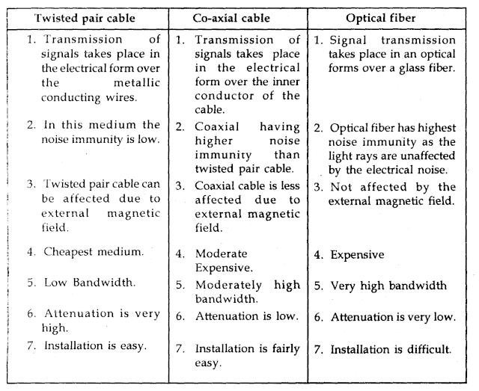

Slide 72
Radio Waves:
Electromagnetic waves ranging in frequencies between 3 KHz and 1 Gits are normally called radio Raven, Radio waves are omnidirectional. When an antenna transmits radio waves, they are propagated thin all directions.
This means that the sending and receiving antennas do not have to be aligned. A sending antenna sends waves that can be received by any receiving antenna. The omnidirectional property has disadvantage, too. The radio waves transmitted by one antennas are susceptible to interference by another antenna that may send signal suing the same frequency or band.
Radio waves, particularly with those of low and medium frequencies, can penetrate walls. This characteristic can be both an advantage and a disadvantage. It is an advantage because, an AM radio can receive signals inside a building. It is a disadvantage because we cannot isolate a communications to just inside or outside a building.

Slide 73
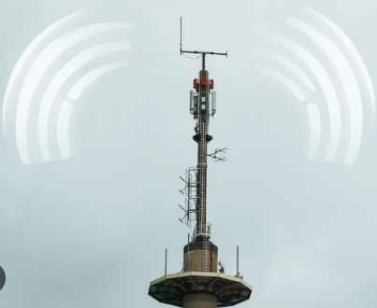
Omnidirectional Antenna for Radio Waves
Radio waves use omnidirectional antennas that send out signals in all directions. Based on the wavelength, strength, and the purpose of transmission, we can have several types of antennas.
Applications of Radio Waves:
The omnidirectional characteristics of radio waves make them useful for multicasting in which there is one sender but many receivers.
AM and FM radio, television, maritime radio, cordless phones, and paging are examples of multicasting.

Slide 74
Advantages of Radio Waves
Wires are not needed as they travel through air, thus a cheaper form of communication.
Some radio waves are reflected off the ionosphere, so can travel around the Earth.
Radio wave can carry a message instantaneously over a wide area.
Aerials to receive radio waves are simpler than for microwaves.
Disadvantages of Radio Waves
The range of frequencies that can be accessed by existing technology is limited, so there is a lot of competition amongst companies for the use of the frequencies
Travel in a straight line, so repeater stations may be needed

Slide 75
Micro Waves
Electromagnetic waves having frequencies between 1 and 300 GHz are called micro waves. Micro means unidirectional.
When an antenna transmits microwaves, they can be narrowly focused. This means that the sending and receiving antennas need to be aligned. The unidirectional property has an obvious advantage. A pair of antennas can be aligned without interfering with another pair of aligned antennas.
The following describes some characteristics of microwaves propagation:
Microwave propagation is line-of-sight. Since the towers with the mounted antennas need to be in direct sight of each other, lowers that are far apart need to be very tall.
Very high frequency microwaves cannot penetrate walls. This characteristics can be a disadvantage if receivers are inside the buildings.
The microwave band is relatively wide, almost 299 GHz. Therefore, wider sub-bands can be assigned and a high date rate is possible.
Use of certain portions of the band requires permission from authorities.

Slide 76
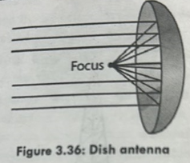
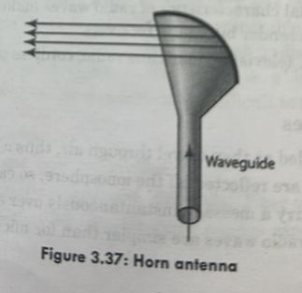
Unidirectional Antenna for Microwaves:
Microwaves need unidirectional antennas that send out signals in one direction. Two types antennas are used for microwave communications: Parabolic Dish and Horn.

Slide 77
A parabolic antenna works as a funnel, catching a wide range of waves and directing them to a common point. In this way, more of the signal is recovered than would be possible with a single-point receiver.
A horn antenna looks like a gigantic scoop. Outgoing transmissions are broadcast up a stem and deflected outward in a series of narrow parallel beams by the curved head. Received transmissions are collected by the scooped shape of the horn, in a manner similar to the parabolic dish, and are deflected down into the stem.
Application:
Microwaves are very useful when unicast(one-to one) communication is needed between the sender and the receiver. They are used in cellular phones, satellite networks and wireless LANs.
There are two types of Microwave Transmission:
Terrestrial Microwave
Satellite Microwave

Slide 78
Advantages of Microwaves
Wires are not needed as they travel through air, thus a cheaper form of communication.
Microwave passes through the ionosphere, so are suitable for satellite to Earth transmission.
Microwave can be modified to carry many signals at one time, including data, television pictures and voice message.
Disadvantages of Microwaves
Absorbed very easily by natural, e.g., rain, and made objects, e.g., concrete. They are also absorbed by living tissue and may cause harm by their cooking effect Microwaves suffer from attenuation due to atmospheric conditions.
Need special aerials to receive them.
Travel in a straight line, so repeater stations may be needed

Slide 79
Terrestrial Microwave
The primary use for terrestrial microwave system is in long haul telecommunications serves, as an alternative to coaxial cable or optical fiber.
The microwave facility requires far fewer amplifiers or repeaters than coaxial cable over the same distance, (typically every 10-100 km) but requires line of sight transmission.
Microwave is commonly used for both voice and television transmission. Another increasingly common use of microwave is for short point-to-point links between buildings, for closed-circuit TV or as a data link between local area networks.
The most common type of microwave antenna is the parabolic "dish", fixed rigidly to focus a narrow beam on a receiving antenna a typical size is about 3 m in diameter. Microwave antennas are usually located at substantial heights above ground level to extend the range between antennas and to be able to transmit over intervening obstacles.
To achieve long-distance transmission, a series of microwave relay towers is used, and point-to-point microwave links are strung together over the desired distance.

Slide 80
Microwave transmission covers a substantial portion of the electromagnetic spectrum, typically in the range 1 to 40 GHz, with 4-6GHz and now 11GHz bands the most common. The higher the frequency used, the higher the potential bandwidth and therefore the higher the potential data rate.
As with any transmission system, a main source of loss is attenuation, related to the square of distance. The effects of rainfall become especially noticeable above 10 GHz. Another source of impairment is interference.

Slide 81
Communication Satellites:
Communication satellites use microwave transmission and are typically used for transmission in large, geographically dispersed organizations that would be difficult to network using cabling media or terrestrial microwave, as well as for home Internet service especially in rural areas.
Satellites are set in geostationary orbits directly over the equator, which rotates in synchronization to earth and hence look stationary from any point on the earth.
Communication satellites are also known as microwave relay stations because they rotate at the precise point and speed above the equator that are stationary to microwave transmission on the ground. These geostationary orbits are place 36000 km above the earth’s surface.

Slide 82
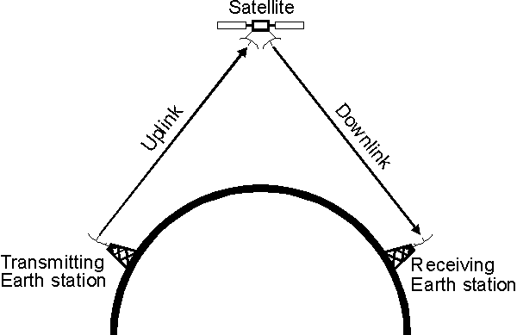
The two stations can use a satellite as a relay station for their communication.
One Earth Station sends a transmission to the satellite. This is called a Uplink. It’s frequency is 6 GHz.
The satellite Transponder converts the signal and sends it down to the second earth station. This is called a Downlink.(4 GHz)

Slide 83
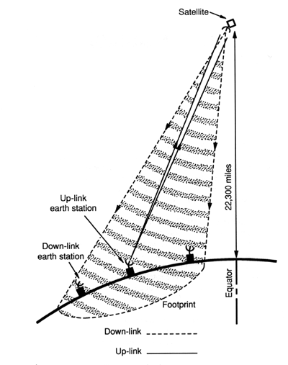
Satellite Footprint:
The footprint of a communications satellite is the ground area that its transponders offer coverage, and determines the satellite dish diameter required to receive each transponder's signal.

Slide 84
Types of Satellite
1. GEO(Geostationary Earth Orbit ):
These satellites are in orbit 35,863 km above the earth’s surface along the equator.
Objects in Geostationary orbit revolve around the earth at the same speed as the earth rotates. This means GEO satellites remain in the same position relative to the surface of earth.
2. LEO(Low Earth Orbit ):
LEO satellites are much closer to the earth than GEO satellites, ranging from 500 to 1,500 km above the surface.
LEO satellites don’t stay in fixed position relative to the surface, and are only visible for 15 to 20 minutes each pass.

Slide 85
3. MEO(Medium Earth Orbit ):
A MEO satellite is in orbit somewhere between 8,000 km and 18,000 km above the earth’s surface.
MEO satellites are similar to LEO satellites in functionality.
MEO satellites are visible for much longer periods of time than LEO satellites, usually between 2 to 8 hours.

Slide 87
Service Types of satellite communication
Service Types
Fixed Service Satellites (FSS)
Example: Point to Point Communication
Broadcast Service Satellites (BSS)
Example: Satellite Television/Radio
Also called Direct Broadcast Service (DBS).
Navigation Service Satellites
Example: Air, Ship, Navigation.
Mobile Service Satellites (MSS)
Example: Satellite Phones

Slide 88
Frequency bands
Different kinds of satellites use different frequency bands.
L–Band: 1 to 2 GHz, used by MSS
S-Band: 2 to 4 GHz, used by MSS, NASA, deep space research
C-Band: 4 to 8 GHz, used by FSS
X-Band: 8 to 12.5 GHz, used by FSS and in terrestrial imaging, ex: military and meteorological satellites
Ku-Band: 12.5 to 18 GHz: used by FSS and BSS
K-Band: 18 to 26.5 GHz: used by FSS and BSS
Ka-Band: 26.5 to 40 GHz: used by FSS
MSS- Mobile Satellite Service
FSS- Fixed Satellite Service
BSS- Broadcasting Satellite Service

Slide 89
Infrared Waves
Infrared waves, with frequencies from 300 GHz to 400 THz, can be used for short-range communication. Infrared waves, with high frequencies, cannot penetrate walls. This prevents interference between one system and with another system.
It is a region of the electromagnetic radiation spectrum where wavelengths range from about 700 nanometers (nm) to 1 millimeter (mm). Infrared waves are longer than those of visible light, but shorter than those of radio waves.
Remote controls use near-infrared light, transmitted with light-emitting diodes (LEDs), to send focused signals to home-entertainment devices, such as televisions. When we use infrared remote control, we do not interfere with the use of the remote by our neighbors. However, this same characteristic makes infrared signals useless for long-range communication. In addition, we cannot use infrared waves outside a building because the sun's rays contain infrared waves that can interfere with the communication. Infrared light is also used in fiber optic cables to transmit data.

Slide 90
Applications of Infrared Waves
The infrared band, almost 400 THz, has an excellent potential for data transmission. Such a wide bandwidth can be used to transmit digital data with a very high data rate.
The Infrared Data Association (IrDA), an association for sponsoring the use of infrared waves, has established standards for using these signals for communication between devices such as keyboards, mouse, PCs and printers.
Infrared signals can be used for short-range communication in a closed area using line- of-sight propagation.

Slide 91
Advantages of Infrared Waves
Can detect people inside burning buildings and cars.
Useful in the military for identifying targets.
Used in scientific experimentation to identify the heat of an object.
Easy to tell what the readings on an infrared camera mean.
Disadvantages of Infrared Waves
Can cause minor burns if exposed to skin for long periods of time.
Can cause cataracts in the eyes after long exposure.
Cheap laser pointers, if without an IR filter, can damage your eyes with Infrared light after a little while of exposure.

Slide 92
Media Selection
Which media are best? It is hard to say, particularly when manufacturers continue to improve various media products. Several factors are important in selecting media.
The type of network is one major consideration. Some media are used only for WANs (microwaves and satellite), whereas others typically are not (twisted pair, coaxial cable, and radio), although we should note that some old WAN networks still use twisted pair cable. Fiber-optic cable is unique in that it can be used for virtually any type of network.
Cost is always a factor in any business decision. Costs are always changing as new technologies are developed and as competition among vendors drives prices down. Among the guided media, twisted pair wire is generally the cheapest, coaxial cable is somewhat more expensive, and fiber-optic cable is the most expensive. The cost of the wireless media is generally driven more by distance than any other factor. For very short distances (several hundred meters), radio is the cheapest; for moderate distances (several hundred miles), microwave is the cheapest; and for long distances, satellite is the cheapest.

Slide 93
Transmission distance is a related factor. Twisted pair wire coaxial cable and radio can transmit data only a short distance before the signal must be regenerated. Twisted pair wire and radio typically can transmit up to 100– 300 meters and coaxial cable typically between 200 and 500 meters. Fiber optics can transmit up to 75 miles, and new types of fiber-optic cable can reach more than 600 miles.
Security is primarily determined by whether the media are guided or wireless. Wireless media (radio, microwave, and satellite) are the least secure because their signals are easily intercepted. Guided media (twisted pair, coaxial, and fiber optics) are more secure, with fiber optics being the most secure.
Error rates are also important. Wireless media are most susceptible to interference and thus have the highest error rates. Among the guided media, fiber optics provides the lowest error rates, coaxial cable the next best, and twisted pair cable the worst, although twisted pair cable is generally better than the wireless media.

Slide 94
Transmission speeds vary greatly among the different media. It is difficult to quote specific speeds for different media because transmission speeds are constantly improving and because they vary within the same type of media, depending on the specific type of cable and the vendor. In general, twisted pair cable and coaxial cable can provide data rates of between 1 Mbps (1 million bits per second) and 1 Gbps (1 billion bits per second), whereas fiber-optic cable ranges between 1 Gbps and 40 Gbps. Radio, microwave, and satellite generally provide 10–100 Mbps.

Slide 95
DIGITAL TRANSMISSION OF DIGITAL DATA
All computer systems produce binary data. For these data to be understood by both the sender and receiver, both must agree on a standard system for representing the letters, numbers, and symbols that compose messages. The coding scheme is the language that computers use to represent data.
Coding:
A character is a symbol that has a common, constant meaning. A character might be the letter A or B, or it might be a number such as 1 or 2. Characters also may be special symbols such as ? or &. Characters in data communications, as in computer systems, are represented by groups of bits that are binary zeros (0) and ones (1). The groups of bits representing the set of characters that are the “alphabet” of any given system are called a coding scheme, or simply a code.

Slide 96
A byte is a group of consecutive bits that is treated as a unit or character. One byte normally is composed of 8 bits and usually represents one character; however, in data communications, some codes use 5, 6, 7, 8, or 9 bits to represent a character. For example, representation of the character A by a group of 8 bits (say, 01 000 001) is an example of coding.
There are three predominant coding schemes ASCII, ISO 8859 and Unicode in use today.
United States of America Standard Code for Information Interchange (USASCII, or, more commonly, ASCII) is the most popular code for data communications and is the standard code on most microcomputers. There are two types of ASCII; one is a 7-bit code that has 128 valid character combinations, and the other is an 8-bit code that has 256 combinations. The number of combinations can be determined by taking the number 2 and raising it to the power equal to the number of bits in the code because each bit has two possible values, a 0 or a 1. In this case 2^7 = 128 characters or 2^8 = 256 characters.

Slide 97
A second commonly used coding scheme is ISO 8859, which is standardized by the International Standards Organization. ISO 8859 is an 8-bit code that includes the ASCII codes plus non-English letters used by many European languages (e.g., letters with accents).
Unicode is the other commonly used coding scheme. There are many different versions of Unicode. UTF-8 (Unicode Transformation Format) is an 8-bit version, which is very similar to ASCII. UTF-16, which uses 16 bits per character (i.e., 2 bytes, called a “word”), is used by Windows. By using more bits, UTF-16 can represent many more characters beyond the usual English or Latin characters, such as Cyrillic or Chinese.

Slide 98

Transmission Mode
Parallel Transmission:
Binary transmission consisting of 1s and 0s may be organized into groups of n bits each. By grouping, we can send n bits data at a time instead of one. The advantage of parallel transmission is speed. But the significant disadvantage is cost and it is limited to short distance.

Slide 99

2. Serial Transmission:
In serial communication one bit follows another so we need only one communication channel rather than ‘n’ number of channels to transmit data between two communicative devices. The advantage of serial transmission is that with only one communication channel, serial transmission reduces the cost of transmission over parallel.

Slide 100
Serial Transmission occurs in two ways:
Asynchronous Transmission:
Asynchronous transmission is so named because the timing of a signal is unimportant.
Instead, information is received and translated by agreed upon patterns.
Each character is usually 8 bits long.
To alert the receiver to the arrival of a new group, therefore, an extra bit is added to the beginning of each byte. This bit, usually a 0, is called the start bit.
To let the receiver know that the byte is finished, 1 or more additional bits are appended to the end of the byte. These bits, usually 1s, are called stop bits.
By this method, each byte is increased in size to at least 10 bits, of which 8 bits is information and 2 bits or more are signals to the receiver.
In addition, the transmission of each byte may then be followed by a gap of varying duration. This gap can be represented either by an idle channel or by a stream of additional stop bits.

Slide 101

The start and stop bits and the gap alert the receiver to the beginning and end of each byte and allow it to synchronize with the data stream.
It is cheap and effective, two advantages that make it an attractive choice for situations such as low-speed communication.
The disadvantage is that the time interval between character cannot be predicted.

Slide 102
2. Synchronous Transmission:
In synchronous transmission, the bit stream is combined into longer "frames," which may contain multiple bytes.
Each byte, however, is introduced onto the transmission link without a gap between it and the next one.
It is left to the receiver to separate the bit stream into bytes for decoding purposes.
In other words, data are transmitted as an unbroken string of 1s and Os, and the receiver separates that string into the bytes, or characters, it needs to reconstruct the information.

Slide 103

Without gaps and start and stop bits, there is no built-in mechanism to help the receiving device adjust its bit synchronization midstream.
Timing becomes very important, therefore, because the accuracy of the received information is completely dependent on the ability of the receiving device to keep an accurate count of the bits as they come in.
The advantage of synchronous transmission is speed.

Slide 104

Data Encoding
Encoding is the process by which data is converted into digital format for efficient transmission of storage. There are four conversion methods.

Slide 105

Digital to Digital Conversion
It is the representation of digital information by a digital signal. Binary 0s and 1s generated by a computer are translated into a sequence of voltage pulse.

Slide 106

1. Unipolar:
All signal levels are on one side of the time axis - either above or below.
In this type 1s are encoded as a positive value and 0s are encoded as 0 value.

Slide 107
2. Polar:
The voltages are on both sides of the time axis.
Polar NRZ scheme can be implemented with two voltages. E.g. +V for 1 and -V for 0.
Types of polar encoding are:
NRZ (Non- Return to Zero)
RZ (Return to Zero)
Biphase

Slide 108
NRZ (Non-Return to Zero):
In NRZ encoding, the level of the signal is always either positive or negative. The two most popular methods of NRZ transmission are:
NRZ - Level (NRZ-L)
NRZ - Inversion (NRZ-I)
NRZ - Level (NRZ-L):
- positive voltage for one symbol and negative for the other
Level of voltage determine value of bit
A positive voltage usually means a bit is 0 and negative voltage means a bit is 1 (or vice versa).

Slide 109
NRZ - Inversion (NRZ-I) :
the change or lack of change in polarity determines the value of a symbol.
In this an inversion of the voltage level represents a bit
A “1” symbol inverts the polarity a “0” does not i.e. a 1 indicates that there is inversion and no inversion if the next bit is 0.

Slide 110


Slide 111

b. Return to Zero (RZ):
The Return to Zero (RZ) scheme uses three voltage values. +, 0, -.
Each symbol has a transition in the middle. Either from high to zero or from low to zero.
1 bit is actually represented by positive to zero and 0 bit by negative to zero.

Slide 112
c. Biphase:
In this method the signal changes at the middle of the bit interval but does not returned to 0 instead it continues to the opposite pole. Two types of biphase.
Manchester ii. Differential Manchester
i. Manchester:
- consists of combining the NRZ-L and RZ schemes.
- In this encoding, the duration of a bit is divided into two halves. Every symbol has a level transition in the middle: from high to low or low to high. Uses only two voltage levels. A low to high transition represents 1 and high to low represents 0.

Slide 113

ii. Differential Manchester:
- consists of combining the NRZ-I and RZ schemes.
Every symbol has a level transition in the middle. But the level at the beginning of the symbol is determined by the symbol value. One symbol causes a level change the other does not.
0 – inversion
1- no inversion

Slide 114
3. Bipolar:
It uses 3 voltage levels: positive, negative and zero.
Types:
i. AMI (Alternate Mark Inversion)
ii. B8ZS (Binary 8 zero substitution)
iii. HDB3 (High Density Bipolar 3)

Slide 115

i. Bipolar Alternate Mark Inversion (AMI):
- the “0” symbol is represented by zero voltage and the “1” symbol alternates between +V and -V.
- Pseudoternary is the reverse of AMI.

Slide 116

ii. B8ZS:
Bipolar With 8 Zeros Substitution
Based on bipolar-AMI
If octet of all zeros and last voltage pulse preceding was positive, encode as 000+-0-+
If octet of all zeros and last voltage pulse preceding was negative, encode as 000-+0+-

Slide 117


Slide 118

iii. HDB3:
It is used into the bipolar AMI pattern every time 4 consecutive 0s are encountered instead of waiting for 8 expected by B8ZS.
In HDB3 if 4 0s come one after another, we change the pattern in 1 of 4 ways based in the polarity of the previous 1 and number of 1s since last substitution.

Slide 119


Slide 120


Slide 121
How Ethernet Transmits Data
The most common technology used in LANs is Ethernet; if you are working in a computer lab on campus, you are most likely using Ethernet.
Ethernet uses digital transmission over either serial or parallel circuits, depending on which version of Ethernet you use. One version of Ethernet that uses serial transmission requires 1/10,000,000 of a second to send one symbol; that is, it transmits 10 million symbols (each of 1 bit) per second.
This gives a data rate of 10 Mbps, and if we assume that there are 8 bits in each character, this means that about 1.25 million characters can be transmitted per second in the circuit.
Ethernet uses Manchester encoding, which is a special type of bipolar signaling in which the signal is changed from high to low or from low to high in the middle of the signal.
A change from high to low is used to represent a 0, whereas the opposite (a change from low to high) is used to represent a 1. Manchester encoding is less susceptible to having errors go undetected, because if there is no transition in midsignal, the receiver knows that an error must have occurred.

Slide 122
Digital to Analog Conversion
It is the process of changing one of the characteristics of an analog signal based on the information in digital data. A sine wave is defined by these characteristics:
- Amplitude
- Frequency
- Phase
When we vary one of these characteristics we create a different version of that wave.
So, by changing one characteristic of a simple electric signal, we can use it to represent digital data.

Slide 123
There are three mechanism for modulating digital data into an analog signal:
- Amplitude Shift Keying (ASK)
- Frequency Shift Keying (FSK)
- Phase Shift Keying (PSK)
Modulation: The process of changing some characteristic of carrier signal (high frequency signal) in accordance with the message signal or information bearing signal (low frequency signal).
Need of Modulation:
- To protect signal from noise and interference
- Transmitting to a longer distance
- Transmitting signal efficiently through the channel.

Slide 124

Amplitude Shift Keying (ASK):
In this technique frequency and phase of the signal remains constant but the amplitude of the signal will be changed.
Mathematically,
s(t) = A cos (2Πft) for binary 1
= 0 for binary 0

Slide 125

Frequency Shift Keying (FSK):
In this technique amplitude and phase of the signal remains constant but the frequency of the signal will be changed.
Mathematically,
s(t) = A cos (2Π F₁t) for binary 0
= A cos (2Π F₂t) for binary 1

Slide 126

Phase Shift Keying (PSK): / (Binary PSK)
In this technique amplitude and frequency of the signal remains constant but the phase of the signal will be changed.
Mathematically,
s(t) = A cos (2Π Ft) for binary 1
= A cos (2Π Ft + Π) = - A cos (2Π Ft) for binary 0

Slide 127

Sending Multiple Bits Simultaneously
Each of the three basic modulation techniques (AM, FM, and PM) can be refined to send more than 1 bit at one time. For example, basic AM sends 1 bit per wave (or symbol) by defining two different amplitudes, one for a 1 and one for a 0. It is possible to send 2 bits on one wave or symbol by defining four different amplitudes. Figure shows the case where the highest-amplitude wave is defined to be a symbol representing 2 bits, both 1s. The next highest amplitude is the symbol defined to mean first a 1 and then a 0, and so on.
Figure: Two-bit amplitude modulation

Slide 128
It is also possible to combine modulation techniques—that is, to use AM, FM, and PM techniques on the same circuit. For example, we could combine AM with four defined amplitudes (capable of sending 2 bits) with FM with four defined frequencies (capable of sending 2 bits) to enable us to send 4 bits on the same symbol.
One popular technique is quadrature amplitude modulation (QAM). QAM involves splitting the symbol into eight different phases (3 bits) and two different amplitudes (1 bit), for a total of 16 different possible values. Thus, one symbol in QAM can represent 4 bits, while 256-QAM sends 8 bits per symbol. 64-QAM and 256-QAM are commonly used in digital TV services and cable modem Internet services.

Slide 129
Bit Rate versus Baud Rate versus Symbol Rate
The terms bit rate (i.e., the number bits per second transmitted) and baud rate are used incorrectly much of the time. They often are used interchangeably, but they are not the same. In reality, the network designer or network user is interested in bits per second because it is the bits that are assembled into characters, characters into words and, thus, business information.
A bit is a unit of information.
A baud is a unit of signaling speed used to indicate the number of times per second the signal on the communication circuit changes.
Because of the confusion over the term baud rate among the general public, ITU-T now recommends the term baud rate be replaced by the term symbol rate. The bit rate and the symbol rate (or baud rate) are the same only when 1 bit is sent on each symbol.

Slide 130
For example, if we use AM with two amplitudes, we send 1 bit on one symbol. Here, the bit rate equals the symbol rate. However, if we use QAM, we can send 4 bits on every symbol; the bit rate would be four times the symbol rate. If we used 64- QAM, the bit rate would be six times the symbol rate. Virtually all of today’s modems send multiple bits per symbol.

Slide 131
Capacity of a Circuit
The data capacity of a circuit is the fastest rate at which you can send your data over the circuit in terms of the number of bits per second. The data rate (or bit rate) is calculated by multiplying the number of bits sent on each symbol by the maximum symbol rate. The number of bits per symbol depends on the modulation technique (e.g., QAM sends 4 bits per symbol).
The maximum symbol rate in any circuit depends on the bandwidth available and the signal-to-noise ratio (the strength of the signal compared with the amount of noise in the circuit).
The bandwidth is the difference between the highest and the lowest frequencies in a band or set of frequencies. The range of human hearing is between 20 Hz and 14,000 Hz, so its bandwidth is 13,880 Hz. The maximum symbol rate for analog transmission is usually the same as the bandwidth as measured in hertz. If the circuit is very noisy, the maximum symbol rate may fall as low as 50% of the bandwidth. If the circuit has very little noise, it is possible to transmit at rates up to the bandwidth.

Slide 132
Digital transmission symbol rates can reach as high as two times the bandwidth for techniques that have only one voltage change per symbol (e.g., NRZ). For digital techniques that have two voltage changes per symbol (e.g., RZ, Manchester), the maximum symbol rate is the same as the bandwidth.
Standard telephone lines provide a bandwidth of 4,000 Hz. Under perfect circumstances, the maximum symbol rate is therefore about 4,000 symbols per second. If we were to use basic AM (1 bit per symbol), the maximum data rate would be 4,000 bits per second (bps). If we were to use QAM (4 bits per symbol), the maximum data rate would be 4 bits per symbol × 4,000 symbols per second = 16,000 bps. A circuit with a 10 MHz bandwidth using 64-QAM could provide up to 60 Mbps.

Slide 133
How Modems Transmit Data
The modem (an acronym for modulator/demodulator) takes the digital data from a computer in the form of electrical pulses and converts them into the analog signal that is needed for transmission over an analog voice-grade circuit.
There are many different types of modems available today from dialup modems to cable modems. For data to be transmitted between two computers using modems, both need to use the same type of modem. Fortunately, several standards exist for modems, and any modem that conforms to a standard can communicate with any other modem that conforms to the same standard.
A modem’s data transmission rate is the primary factor that determines the throughput rate of data, but it is not the only factor.

Slide 134
Data compression can increase throughput of data over a communication link by literally compressing the data. V.44, the ISO standard for data compression, uses Lempel–Ziv encoding. As a message is being transmitted, Lempel–Ziv encoding builds a dictionary of two-, three-, and four-character combinations that occur in the message.
Anytime the same character pattern reoccurs in the message, the index to the dictionary entry is transmitted rather than sending the actual data. The reduction provided by V.44 compression depends on the actual data sent but usually averages about 6:1 (i.e., almost six times as much data can be sent per second using V.44 as without it).

Slide 135
Digital Transmission of Analog Data
In the same way that digital computer data can be sent over analog telephone networks using analog transmission, analog voice data can be sent over digital networks using digital transmission. This process is somewhat similar to the analog transmission of digital data.
A pair of special devices called codecs (code/decode) is used in the same way that a pair of modems is used to translate the data to send across the circuit. One codec is attached to the source of the signal (e.g., a telephone or the local loop at the end office) and translates the incoming analog voice signal into a digital signal for transmission across the digital circuit. A second codec at the receiver’s end translates the digital data back into analog data.

Slide 136
Translating from Analog to Digital
Many sources of information are analog, which means they must be converted to digital form for further processing (eg: before they can be encrypted). There are two basic approaches: pulse code modulation and delta modulation.
Pulse Code Modulation (PCM):
The most common technique to change an analog signal to digital data (digitization) is called pulse code modulation (PCM). A PCM encoder has three processes ( sampling, quantizing, encoding) as shown in figure below:

Slide 137

The analog signal is sampled.
The sampled signal is quantized.
The quantized values are encoded as streams of bits.

Slide 138
Sampling: The analog signal is sampled every T interval. Most important factor in sampling is the rate at which analog signal is sampled. According to Nyquist Theorem, the sampling rate must be at least two times of the highest frequency of the signal.
Quantization: Sampling yields discrete form of continuous analog signal. Every discrete pattern shows the amplitude of the analog signal at that instance. The quantization is done between the maximum amplitude value and the minimum amplitude value. Quantization is approximation of the instantaneous analog value.
Encoding: The quantized values (approximated) are then encoded into binary representations, which are typically in the form of binary numbers. The bit depth of the A/D conversion determines the number of bits used to represent each sample, and the binary representation reflects the amplitude of the analog signal at that moment in time.

Slide 139
Delta Modulation:
The chief alternative to pulse code modulation is known as delta modulation. Delta modulation also takes samples.
However, instead of sending a quantization for each sample, delta modulation sends one quantization value followed by a string of values that give the difference between the previous value and the current value.
The idea is that transmitting differences requires fewer bits than transmitting full values, especially if the signal does not vary rapidly.
The main tradeoff with delta modulation arises from the effect of an error - if any item in the sequence is lost or damaged, all successive values will be misinterpreted. Thus, communication systems that expect data values to be lost or changed during transmission usually use pulse code modulation (PCM).

Slide 140
How Telephones Transmit Voice Data
When you make a telephone call, the telephone converts your analog voice data into a simple analog signal and sends it down the circuit from your home to the telephone company’s network.
This process is almost unchanged from the one used by Bell when he invented the telephone in 1876. With the invention of digital transmission, the common carriers (i.e., the telephone companies) began converting their voice networks to use digital transmission.
Today, all of the common carrier networks use digital transmission, except in the local loop (sometimes called the last mile), the wires that run from your home or business to the telephone switch that connects your local loop into the telephone network. This switch contains a codec that converts the analog signal from your phone into a digital signal. This digital signal is then sent through the telephone network until it hits the switch for the local loop for the person you are calling.

Slide 141

This switch uses its codec to convert the digital signal used inside the phone network back into the analog signal needed by that person’s local loop and telephone.
Figure: Pulse Amplitude Modulation

Slide 142
There are many different combinations of sampling frequencies and numbers of bits per sample that could be used. For example, one could sample 4,000 times per second using 128 amplitude levels (i.e., 7 bits) or sample at 16,000 times per second using 256 levels (i.e., 8 bits).
The North American telephone network uses pulse code modulation (PCM). With PCM, the input voice signal is sampled 8,000 times per second. Each time the input voice signal is sampled, 8 bits are generated. Therefore, the transmission speed on the digital circuit must be 64,000 bps (8 bits per sample × 8,000 samples per second) to transmit a voice signal when it is in digital form.
Thus, the North American telephone network is built using millions of 64 Kbps digital circuits that connect via codecs to the millions of miles of analog local loop circuits into the users’ residences and businesses.

Slide 143
How Instant Messenger Transmits Voice Data
A 64 Kbps digital circuit works very well for transmitting voice data because it provides very good quality. The problem is that it requires a lot of capacity. Adaptive differential pulse code modulation (ADPCM) is the alternative used by IM and many other applications that provide voice services over lower-speed digital circuits.
ADPCM is a digital audio compression technique commonly used to reduce the data rate of audio signals. Unlike standard Pulse Code Modulation (PCM), which encodes each audio sample independently, ADPCM quantizes the difference between consecutive samples, adapting the quantization step size based on signal characteristics. This adaptive approach allows ADPCM to compress data efficiently while maintaining acceptable audio quality.

Slide 144
Predictive coding is a core feature, where each sample is predicted based on previous ones, and the difference between the predicted and actual sample is quantized and transmitted. ADPCM is often used in real-time applications, such as voice over IP communication and digital telephony, where conserving bandwidth and minimizing data transmission delays are important considerations.

Slide 145
Voice over Internet Protocol (VoIP)
Voice over Internet Protocol (VoIP) is a revolutionary technology that enables the transmission of voice and multimedia content over the Internet and IP-based networks.
It converts analog audio signals into digital data, which is then transmitted in packets over the internet. This process involves several key steps, including analog-to-digital conversion, packetization, internet transmission, and digital-to-analog conversion (if the recipient uses traditional phone equipment).
VoIP relies on specific protocols like SIP (Session Initiation Protocol) and H.323 for call setup and control and implements Quality of Service mechanisms to prioritize voice traffic, ensuring low latency and high call quality. VoIP is known for its cost-efficiency, as it leverages existing internet infrastructure, reducing long-distance call charges.
It offers various features such as call forwarding, voicemail, and video conferencing, making it an essential technology for both personal and business communication. VoIP has transformed the way people communicate, enabling more affordable, flexible, and versatile voice communication options.

